Slide 1
William Stallings
Computer Organization and Architecture
7th Edition
Chapter 6
External Memory

Slide 2
Types of External Memory
Magnetic Disk
  RAID
  Removable
Optical
  CD-ROM
  CD-Recordable (CD-R)
  CD-R/W
  DVD
Magnetic Tape

Slide 3
Magnetic Disk
Disk substrate coated with magnetizable material (iron oxide…rust)
Substrate used to be aluminium
Now glass
  Improved surface uniformity
    Increases reliability
  Reduction in surface defects
    Reduced read/write errors
  Lower flight heights (See later)
  Better stiffness
  Better shock/damage resistance

Slide 4
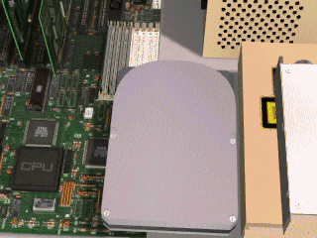

Slide 5
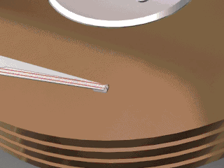

Slide 6
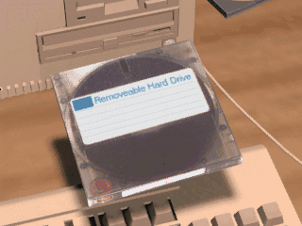

Slide 7
Read and Write Mechanisms
Recording & retrieval via conductive coil called a head
May be single read/write head or separate ones
During read/write, head is stationary, platter rotates
Write
  Current through coil produces magnetic field
  Pulses sent to head
  Magnetic pattern recorded on surface below
Read (traditional)
  Magnetic field moving relative to coil produces current
  Coil is the same for read and write
Read (contemporary)
  Separate read head, close to write head
  Partially shielded magneto resistive (MR) sensor
  Electrical resistance depends on direction of magnetic field
  High frequency operation
    Higher storage density and speed

Slide 8
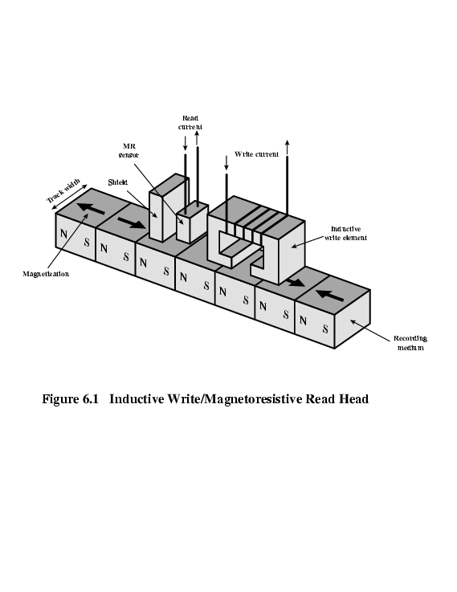
Inductive Write MR Read

Slide 9
Data Organization and Formatting
Concentric rings or tracks
  Gaps between tracks
  Reduce gap to increase capacity
  Same number of bits per track (variable packing density)
  Constant angular velocity
Tracks divided into sectors
Minimum block size is one sector
May have more than one sector per block

Slide 10
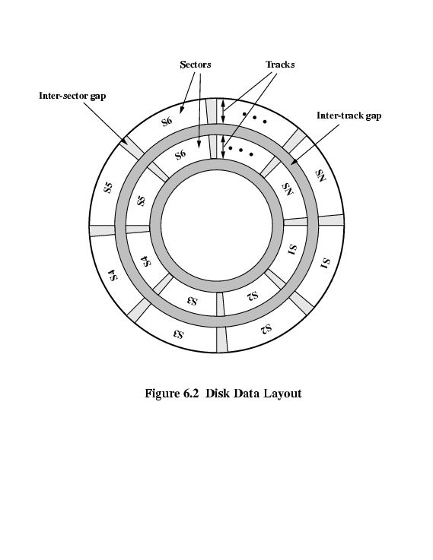
Disk Data Layout

Slide 11
Disk Velocity
Bit near centre of rotating disk passes fixed point slower than bit on outside of disk
Increase spacing between bits in different tracks
Rotate disk at constant angular velocity (CAV)
  Gives pie shaped sectors and concentric tracks
  Individual tracks and sectors addressable
  Move head to given track and wait for given sector
  Waste of space on outer tracks
    Lower data density
Can use zones to increase capacity
  Each zone has fixed bits per track
  More complex circuitry

Slide 12
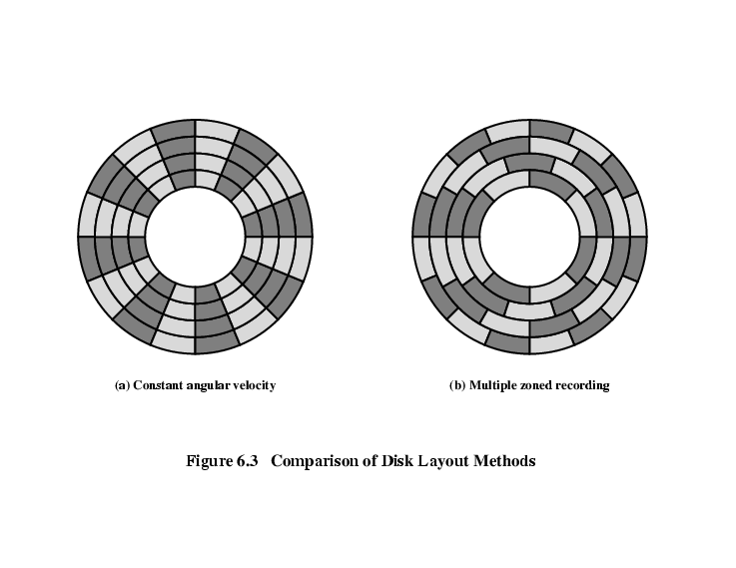
Disk Layout Methods Diagram

Slide 13
Finding Sectors
Must be able to identify start of track and sector
Format disk
  Additional information not available to user
  Marks tracks and sectors

Slide 14
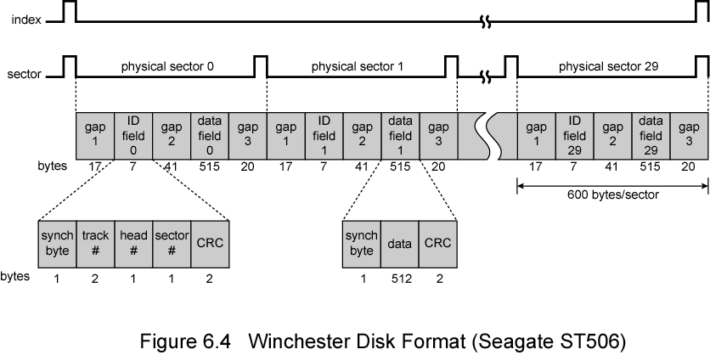
Winchester Disk Format
Seagate ST506

Slide 15
Characteristics
Fixed (rare) or movable head
Removable or fixed
Single or double (usually) sided
Single or multiple platter
Head mechanism
  Contact (Floppy)
  Fixed gap
  Flying (Winchester)

Slide 16
Fixed/Movable Head Disk
Fixed head
  One read write head per track
  Heads mounted on fixed ridged arm
Movable head
  One read write head per side
  Mounted on a movable arm

Slide 17
Removable or Not
Removable disk
  Can be removed from drive and replaced with another disk
  Provides unlimited storage capacity
  Easy data transfer between systems
Nonremovable disk
  Permanently mounted in the drive

Slide 18
Multiple Platter
One head per side
Heads are joined and aligned
Aligned tracks on each platter form cylinders
Data is striped by cylinder
  reduces head movement
  Increases speed (transfer rate)

Slide 19
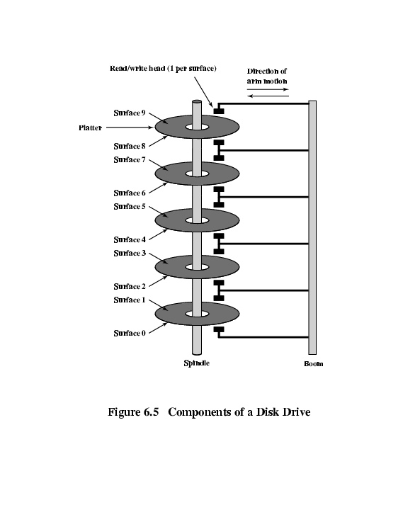
Multiple Platters

Slide 20
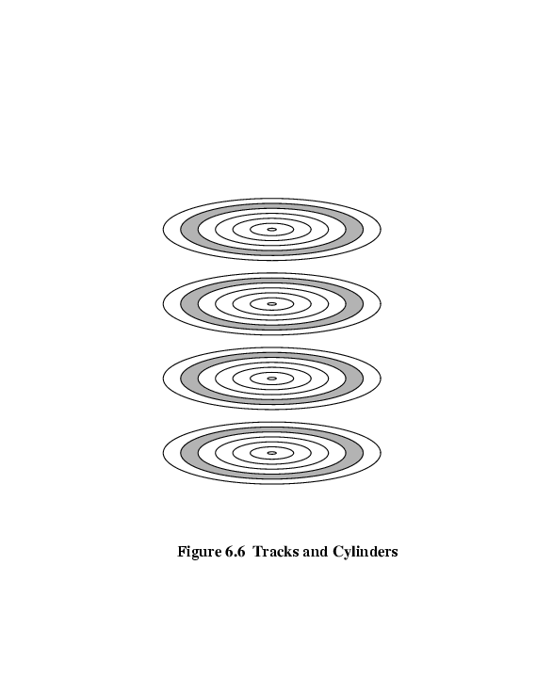
Tracks and Cylinders

Slide 21
Floppy Disk
8”, 5.25”, 3.5”
Small capacity
  Up to 1.44Mbyte (2.88M never popular)
Slow
Universal
Cheap
Obsolete?

Slide 22
Winchester Hard Disk (1)
Developed by IBM in Winchester (USA)
Sealed unit
One or more platters (disks)
Heads fly on boundary layer of air as disk spins
Very small head to disk gap
Getting more robust

Slide 23
Winchester Hard Disk (2)
Universal
Cheap
Fastest external storage
Getting larger all the time
  250 Gigabyte now easily available

Slide 24
Speed
Seek time
  Moving head to correct track
(Rotational) latency
  Waiting for data to rotate under head
Access time = Seek + Latency
Transfer rate

Slide 25
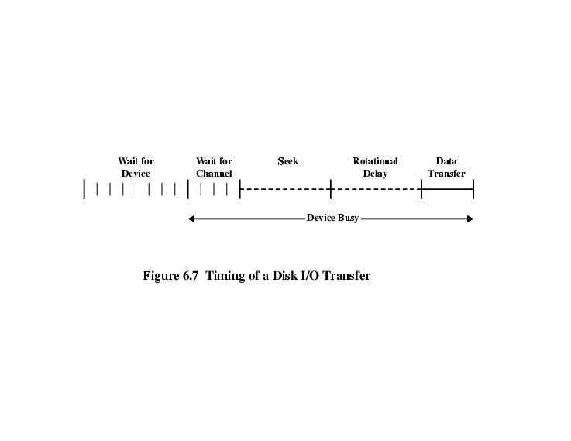
Timing of Disk I/O Transfer

Slide 26
RAID
Redundant Array of Independent Disks
Redundant Array of Inexpensive Disks
6 levels in common use
Not a hierarchy
Set of physical disks viewed as single logical drive by O/S
Data distributed across physical drives
Can use redundant capacity to store parity information

Slide 27
RAID 0
No redundancy
Data striped across all disks
Round Robin striping
Increase speed
  Multiple data requests probably not on same disk
  Disks seek in parallel
  A set of data is likely to be striped across multiple disks

Slide 28
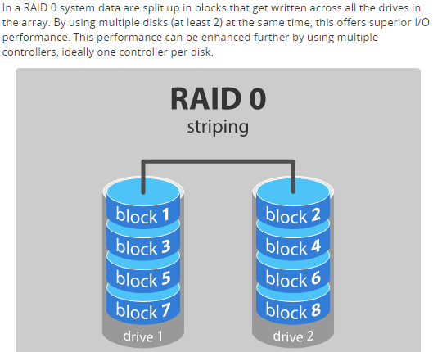
RAID level 0 – Striping
Notes:
Advantages
RAID 0 offers great performance, both in read and write operations. There is no overhead caused by parity controls.
All storage capacity is used, there is no overhead.
The technology is easy to implement.
Disadvantages
RAID 0 is not fault-tolerant. If one drive fails, all data in the RAID 0 array are lost. It should not be used for mission-critical systems.
Ideal use
RAID 0 is ideal for non-critical storage of data that have to be read/written at a high speed, such as on an image retouching or video editing station.
If you want to use RAID 0 purely to combine the storage capacity of twee drives in a single volume, consider mounting one drive in the folder path of the other drive. This is supported in Linux, OS X as well as Windows and has the advantage that a single drive failure has no impact on the data of the second disk or SSD drive.

Slide 29
RAID 1
Mirrored Disks
Data is striped across disks
2 copies of each stripe on separate disks
Read from either
Write to both
Recovery is simple
  Swap faulty disk & re-mirror
  No down time
Expensive

Slide 30
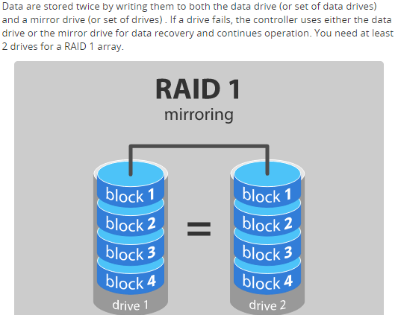
RAID level 1 – Mirroring
Notes:
Advantages
RAID 1 offers excellent read speed and a write-speed that is comparable to that of a single drive.
In case a drive fails, data do not have to be rebuild, they just have to be copied to the replacement drive.
RAID 1 is a very simple technology.
Disadvantages
The main disadvantage is that the effective storage capacity is only half of the total drive capacity because all data get written twice.
Software RAID 1 solutions do not always allow a hot swap of a failed drive. That means the failed drive can only be replaced after powering down the computer it is attached to. For servers that are used simultaneously by many people, this may not be acceptable. Such systems typically use hardware controllers that do support hot swapping.
Ideal use
RAID-1 is ideal for mission critical storage, for instance for accounting systems. It is also suitable for small servers in which only two data drives will be used.

Slide 31
RAID 2
Disks are synchronized
Very small stripes
  Often single byte/word
Error correction calculated across corresponding bits on disks
Multiple parity disks store Hamming code error correction in corresponding positions
Lots of redundancy
  Expensive
  Not used

Slide 32
RAID 3
Similar to RAID 2
Only one redundant disk, no matter how large the array
Simple parity bit for each set of corresponding bits
Data on failed drive can be reconstructed from surviving data and parity info
Very high transfer rates

Slide 33
RAID 4
Each disk operates independently
Good for high I/O request rate
Large stripes
Bit by bit parity calculated across stripes on each disk
Parity stored on parity disk

Slide 34
RAID 5
Like RAID 4
Parity striped across all disks
Round robin allocation for parity stripe
Avoids RAID 4 bottleneck at parity disk
Commonly used in network servers
N.B. DOES NOT MEAN 5 DISKS!!!!!

Slide 35
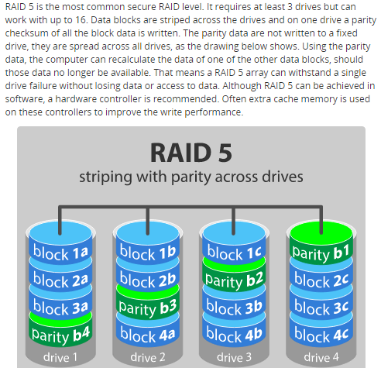
RAID level 5
Notes:
Advantages
Read data transactions are very fast while write data transactions are somewhat slower (due to the parity that has to be calculated).
If a drive fails, you still have access to all data, even while the failed drive is being replaced and the storage controller rebuilds the data on the new drive.
Disadvantages
Drive failures have an effect on throughput, although this is still acceptable.
This is complex technology. If one of the disks in an array using 4TB disks fails and is replaced, restoring the data (the rebuild time) may take a day or longer, depending on the load on the array and the speed of the controller. If another disk goes bad during that time, data are lost forever.
Ideal use
RAID 5 is a good all-round system that combines efficient storage with excellent security and decent performance. It is ideal for file and application servers that have a limited number of data drives.

Slide 36
RAID 6
Two parity calculations
Stored in separate blocks on different disks
User requirement of N disks needs N+2
High data availability
  Three disks need to fail for data loss
  Significant write penalty

Slide 37
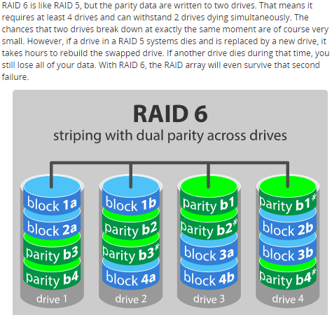
RAID level 6 – Striping with double parity
Notes:
Advantages
Like with RAID 5, read data transactions are very fast.
If two drives fail, you still have access to all data, even while the failed drives are being replaced. So RAID 6 is more secure than RAID 5.
Disadvantages
Write data transactions are slowed down due to the parity that has to be calculated.
Drive failures have an effect on throughput, although this is still acceptable.
This is complex technology. Rebuilding an array in which one drive failed can take a long time.
Ideal use
RAID 6 is a good all-round system that combines efficient storage with excellent security and decent performance. It is preferable over RAID 5 in file and application servers that use many large drives for data storage.

Slide 38
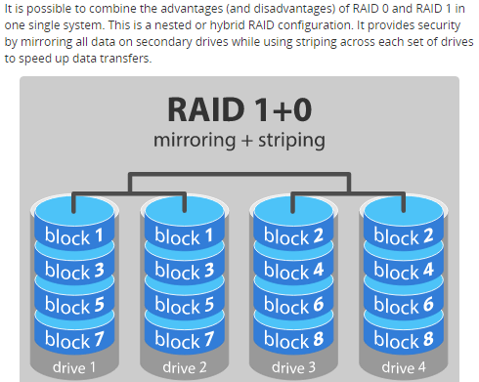
RAID level 10 – combining RAID 1 & RAID 0
Notes:
Advantages
If something goes wrong with one of the disks in a RAID 10 configuration, the rebuild time is very fast since all that is needed is copying all the data from the surviving mirror to a new drive. This can take as little as 30 minutes for drives of 1 TB.
Disadvantages
Half of the storage capacity goes to mirroring, so compared to large RAID 5 or RAID 6 arrays, this is an expensive way to have redundancy.
What about RAID levels 2, 3, 4 and 7?
These levels do exist but are not that common (RAID 3 is essentially like RAID 5 but with the parity data always written to the same drive). This is just a simple introduction to RAID-systems. You can find more in-depth information on the pages of wikipedia or ACNC.
RAID is no substitute for back-up!
All RAID levels except RAID 0 offer protection from a single drive failure. A RAID 6 system even survives 2 disks dying simultaneously. For complete security you do still need to back-up the data from a RAID system.
That back-up will come in handy if all drives fail simultaneously because of a power spike.
It is a safeguard when the storage system gets stolen.
Back-ups can be kept off-site at a different location. This can come in handy if a natural disaster or fire destroys your workplace.
The most important reason to back-up multiple generations of data is user error. If someone accidentally deletes some important data and this goes unnoticed for several hours, days or weeks, a good set of back-ups ensure you can still retrieve those files.

Slide 39
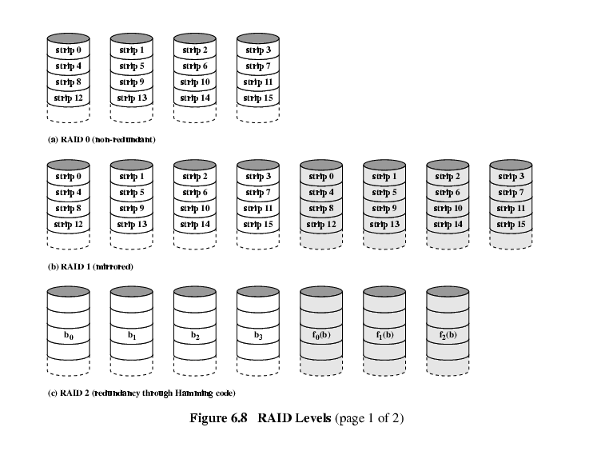
RAID 0, 1, 2

Slide 40
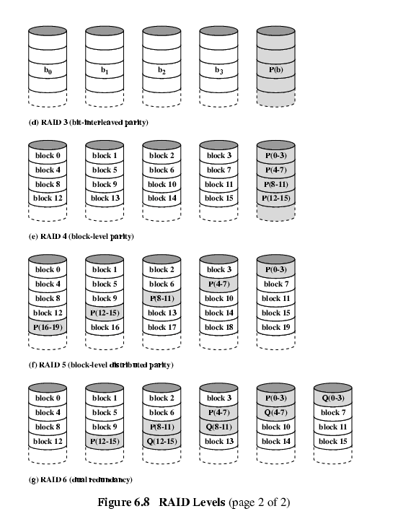
RAID 3 & 4

Slide 41
RAID 5 & 6

Slide 42
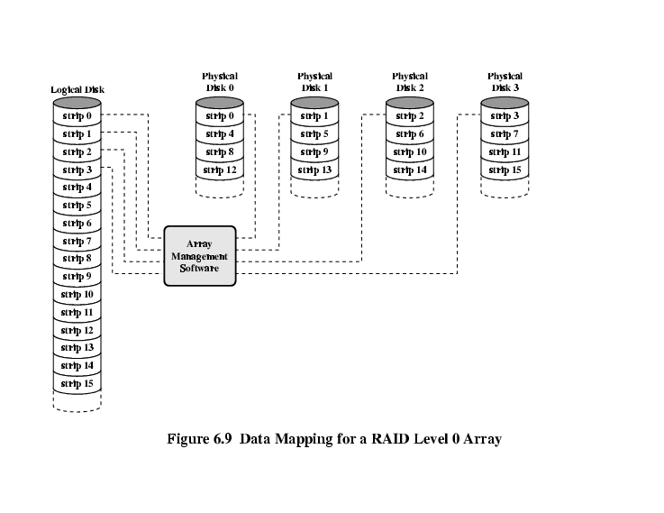
Data Mapping For RAID 0

Slide 43
Research Assignment
Opportunities and challenges in RAID

Slide 44
Optical Storage CD-ROM
Originally for audio
650Mbytes giving over 70 minutes audio
Polycarbonate coated with highly reflective coat, usually aluminium
Data stored as pits
Read by reflecting laser
Constant packing density
Constant linear velocity

Slide 45
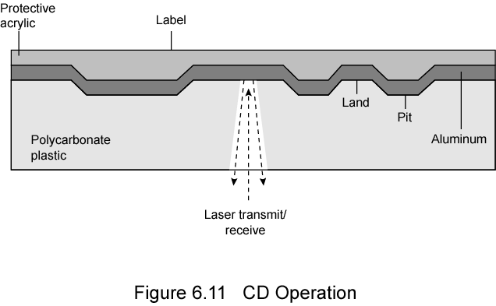
CD Operation

Slide 46
CD-ROM Drive Speeds
Audio is single speed
  Constant linier velocity
  1.2 ms⁻¹
  Track (spiral) is 5.27km long
  Gives 4391 seconds = 73.2 minutes
Other speeds are quoted as multiples
e.g. 24x
Quoted figure is maximum drive can achieve

Slide 47
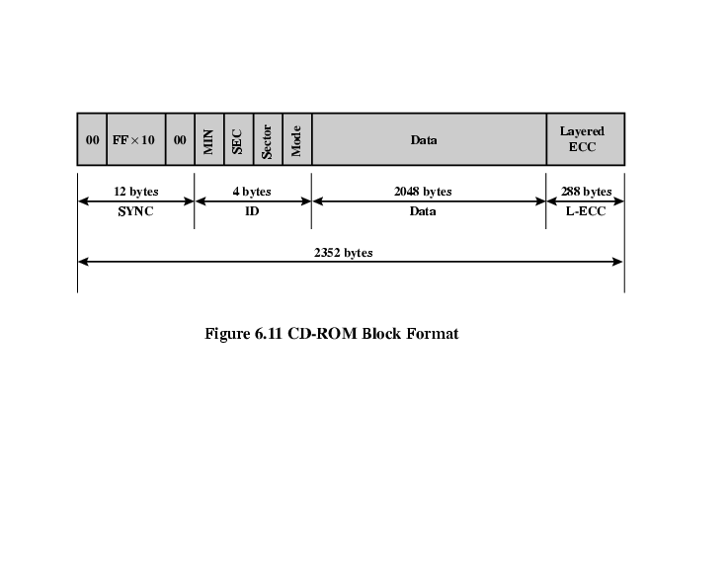
CD-ROM Format
Mode 0=blank data field
Mode 1=2048 byte data+error correction
Mode 2=2336 byte data

Slide 48
Random Access on CD-ROM
Difficult
Move head to rough position
Set correct speed
Read address
Adjust to required location
(Yawn!)

Slide 49
CD-ROM for & against
Large capacity (?)
Easy to mass produce
Removable
Robust
Expensive for small runs
Slow
Read only

Slide 50
Other Optical Storage
CD-Recordable (CD-R)
  WORM
  Now affordable
  Compatible with CD-ROM drives
CD-RW
  Erasable
  Getting cheaper
  Mostly CD-ROM drive compatible
  Phase change
    Material has two different reflectivities in different phase states

Slide 51
DVD - what’s in a name?
Digital Video Disk
  Used to indicate a player for movies
    Only plays video disks
Digital Versatile Disk
  Used to indicate a computer drive
    Will read computer disks and play video disks
Dogs Veritable Dinner
Officially - nothing!!!

Slide 52
DVD - technology
Multi-layer
Very high capacity (4.7G per layer)
Full length movie on single disk
  Using MPEG compression
Finally standardized (honest!)
Movies carry regional coding
Players only play correct region films
Can be “fixed”

Slide 53
DVD – Writable
Loads of trouble with standards
First generation DVD drives may not read first generation DVD-W disks
First generation DVD drives may not read CD-RW disks
Wait for it to settle down before buying!

Slide 54
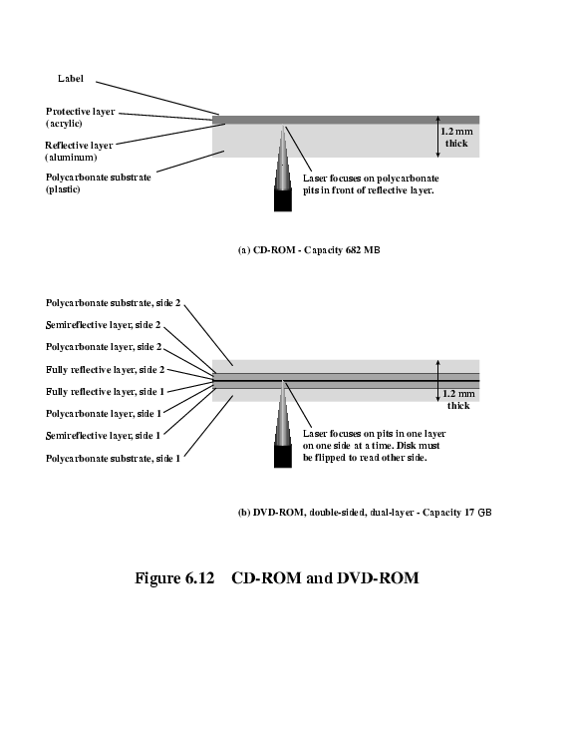
CD and DVD

Slide 55
Magnetic Tape
Serial access
Slow
Very cheap
Backup and archive

Slide 56
Internet Resources
Optical Storage Technology Association
  Good source of information about optical storage technology and vendors
  Extensive list of relevant links
DLTtape
  Good collection of technical information and links to vendors
Search on RAID

Slide 57
Some exercise questions
6.1 What are the advantages of using a glass substrate for a magnetic disk?
6.2 How are data written onto a magnetic disk?
6.3 The read head consists of a partially shielded magnetoresistive (MR) sensor. The
6.5 Define the terms track, cylinder, and sector.
Notes:
6.1 Improvement in the uniformity of the magnetic film surface to increase disk
reliability. A significant reduction in overall surface defects to help reduce
read/write errors. Ability to support lower fly heights (described subsequently).
Better stiffness to reduce disk dynamics. Greater ability to withstand shock and
Damage
6.2 The write mechanism is based on the fact that electricity flowing through a coil
produces a magnetic field. Pulses are sent to the write head, and magnetic patterns
are recorded on the surface below, with different patterns for positive and negative
currents. An electric current in the wire induces a magnetic field across the gap,
which in turn magnetizes a small area of the recording medium. Reversing the
direction of the current reverses the direction of the magnetization on the recording
medium.
The read head consists of a partially shielded magnetoresistive (MR) sensor. The
MR material has an electrical resistance that depends on the direction of the
magnetization of the medium moving under it. By passing a current through the
MR sensor, resistance changes are detected as voltage signals.
6.5 On a magnetic disk. data is organized on the platter in a concentric set of rings,
called tracks. Data are transferred to and from the disk in sectors. For a disk with
multiple platters, the set of all the tracks in the same relative position on the platter
is referred to as a cylinder.

Slide 58
Some exercise questions
6.7 Define the terms seek time, rotational delay, access time, and transfer time.
6.8 What common characteristics are shared by all RAID levels?
6.9 Briefly define the seven RAID levels.
6.10 Explain the term striped data.
6.11 How is redundancy achieved in a RAID system?
6.12 In the context of RAID, what is the distinction between parallel access and independent
access?
6.13 What is the difference between CAV and CLV?
6.14 What differences between a CD and a DVD account for the larger capacity of the latter?
6.15 Explain serpentine recording.

Slide 59
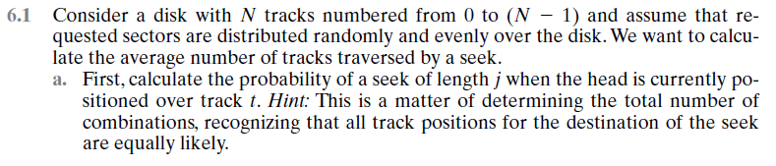
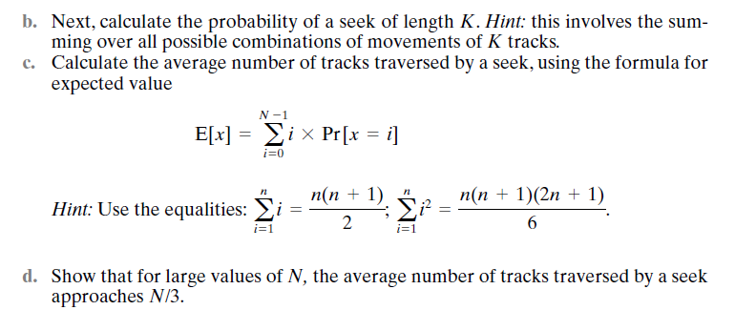
Some questions from exercise

Slide 60
